Slide 1
Avalanche Forecasting Using Machine Learning
PROJECT REPORT
SUBMITTED BY:
INDHIRA JOTHI S
MANJU REKHA S
RAMYA L S
JAYALAKSHMI S

Slide 2
INTRODUCTION:
The word Avalanche refers to snow and ice. It means a mass of snow, ice, rocks, slush falling rapidly down a mountain. Snow avalanches are among the most destructive natural hazards threatening human life, ecosystems, built structures, and landscapes in mountainous regions. Each year avalanche kills more than 150 people worldwide. The most common cause of death by avalanche is asphyxiation. If the person buried under an avalanche more than 15 minutes then there is no chance of survive. So, the life of the people in that region is difficult to live. This project prevent the people from the avalanche by priory informing them there is a chance to the occurrence of avalanche or not.
1.1 OVERVIEW :
Avalanche is leading cause of major event occur in winter or spring.
This may cause severe diaster to human and many lives .In this paper
We demonstrate of the use of Machine Learning to build the model
Which predicts the avalanche level .

Slide 3
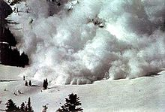
1.2 PURPOSE
The main objective is to prevent the people from the avalanche by priory informing them there is a chance to the occurrence of avalanche or not. The model gets the data from the IOT based sensors. After that we want to process those data using a suitable algorithm, then our model display whether the avalanche occur or not and how strength it was. To analyse the data coming from different sensors we are applying various machine learning algorithms. If there is a chance of avalanche then the notification will be sent to people so that they can take decisions accordingly.

Slide 4
2. LITERATURE SURVEY :
2.1 EXISTING PROBLEM :
With the collected data of slope , forest density , snow density ,
Air temperature and wind , the main aim of the project is there is a chance of avalanche then the notification will be sent to people so that they can take decisions accordingly.
2.2 PROPOSED SOLUTION :
The model gets the data from the IOT based sensors. With the collected data the model is build with the machine learning algorithm and proposed steps applied to those data, then our model display whether the avalanche occur or not and how strength it was. If there is a chance of avalanche then the notification will be sent to people so that they can take decisions accordingly. Here with these steps we proceed our model , first the data is collected with
the specific resource. Secondly the collected data is preprocessed by importing libraries , importing dataset additional structuring the data using data visualization , taking care of missing data , label encoding , one hot encoding , feature scaling and spliting the data
Into dependent and independent variable .

Slide 5
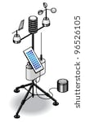
Thirdly our model is build with the train and test technique and evaluated to check
Whether our model prediction is correct or not . Then our model is deployed with
The web application created using html code and python code.
3. THEORETICAL ANALYSIS :
3.1 BLOCK DIAGRAM
Capture the data
From the iot source
Data preprocessing
low
Deploy model
Using web app
Predict the
stage
Data modeling
moderate
high

Slide 6

3.2 HARDWARE / SOFTWARE DESIGNING :
For hardware we need IOT based sensors . With the IOT based sensors
We collect the data which Is given as input to the web page
For software we need compatible operating system for python,
HTML and CSS . Software used for python implementation
And web deployment
Numpy , pandas , matplotlib
Flask
4 EXPERIMENTAL INVESTIGATION :
The avalanche is predicted with the given input level such as
Slope
Forest density
Snow density
Air temperature
wind

Slide 7
5 FLOW CHART
DATA
COLLECTION
IMPORT LIBRARIES
DATA VISUALIZATION
DATA PREPROCESSING
TAKING CARE OF MISSING DATA
LABEL ENCODING
SPLITTING DATA INTO TRAIN AND TEST
MODEL BUILDING
TRAINING AND TESTING DATA
EVALUATION
APPLICATION BUILDING
CREATING HTML FILE
PREDICTION
BUILDING PYTHON CODE

Slide 8

6 RESULT
We got an accuracy of 0.95 which is a good measure for a Machine
Learning algorithm used called Random Forest Classifier
The model predicts the avalanche chances with good efficiency
7 ADVANTAGE & DISADVANTAGE :
ADVANTAGE
Effective prediction of avalanche chances
Easily accessible web framework
Efficiency is maintained asap by updating data
DISADVANTAGE
To predict the efficient output , necessary input is required
Updating the dataset is tedious process

Slide 9
8 APPLICATION
Avalanche plays an important event during winter and spring.
The application using flask frame with the help of machine
Learning model Random forest classifier , with this application
We can help may lives
9 CONCLUSION
Using Machine learning model we predict the chance of avalanche whether
The avalanche chance is low , moderate or high with the required input such as
Slope
Forest density
Snow density
Air temperature
wind
Hence the avalanche chances will be predicted in remote places
10 FUTURE SCOPE
Using avalanche prediction we could predict time that at which time
There is a chance of avalanche occur.

Slide 10
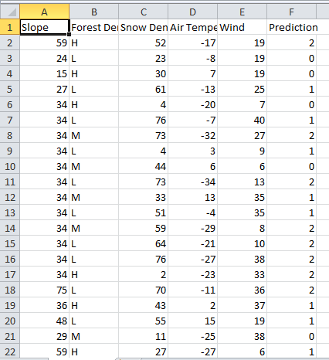
11 BIBILOGRAPHY
Dataset – kaggle https://www.kaggle.com/aaroncareaga/avalanche-forecasting/data
12 APPENDIX
12.1 DATASET

Slide 11
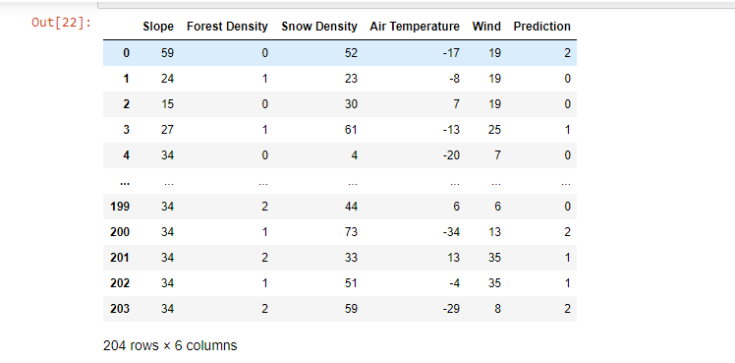
12.2 PRE – PROCESSING DATA

Slide 12

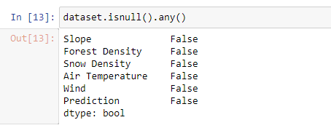
12.3 DATA PREPROCESSING CODE

Slide 13
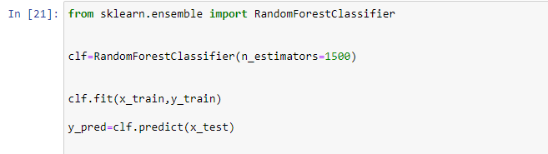
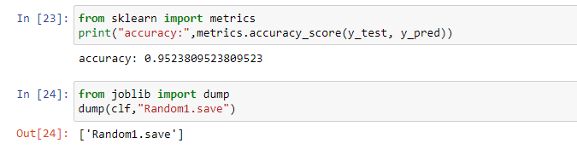
12.4 MODEL TRAINING

Slide 14
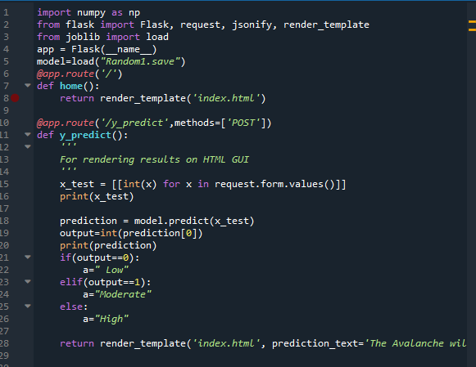
12.5 FLASK

Slide 15
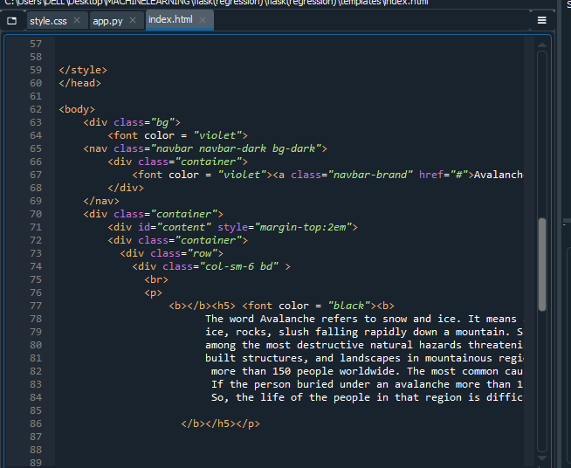

Slide 16
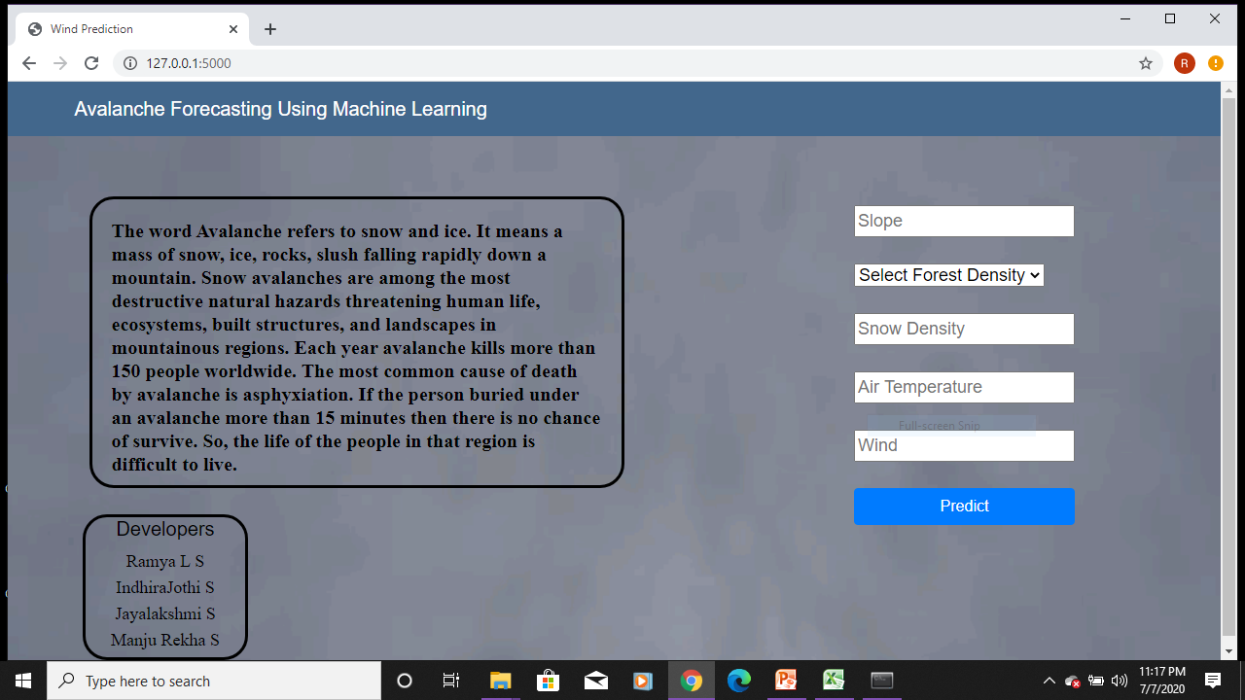
BEFORE PREDICTION

Slide 17
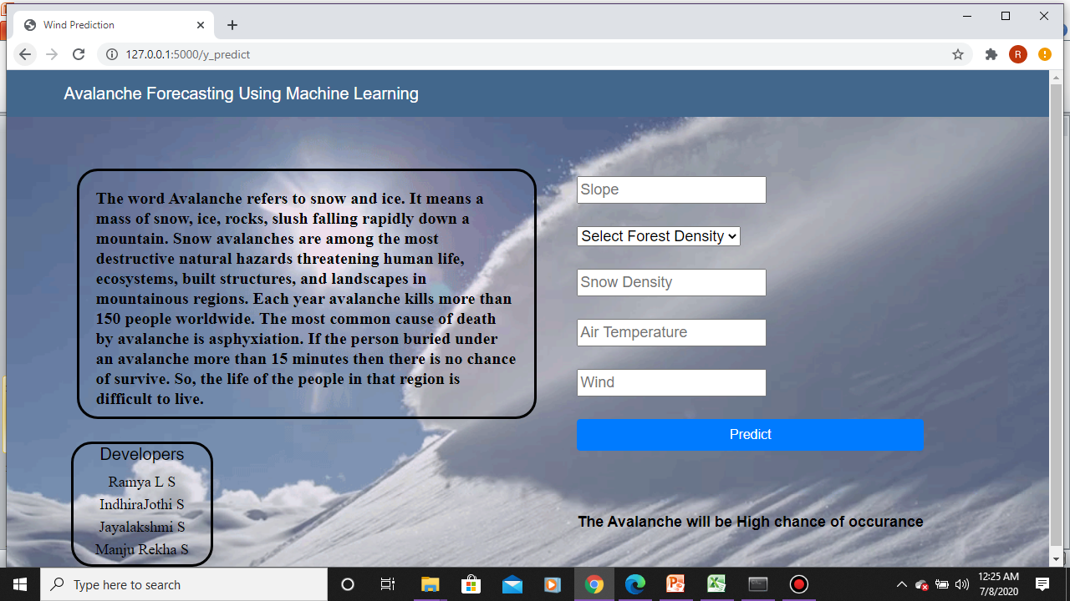
AFTER PREDICTION

